Slide 1
ADCS Sensors/Requirements
Flight Software/GNC Team
AA 236A – Spacecraft Design
9/30/2019

Slide 2
Requirements Overview
Pointing accuracy <10 degrees (mission derived)
Navigation Requirements – How good does our knowledge have to be to achieve the mission requirement?
Control Requirements
Software Requirements
Sensor Requirements

Slide 3
Components Survey Summary
Sensors surveyed:
Sun Sensors
Magnetometers
Gyroscopes
IMUs
Star Trackers
Earth Limb Sensors
The two-unit vector question (for filter initialization)
Sun sensor
Limb sensor
Magnetometer
Nadir Sensor

Slide 4
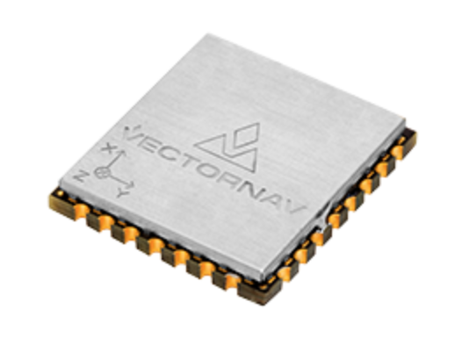
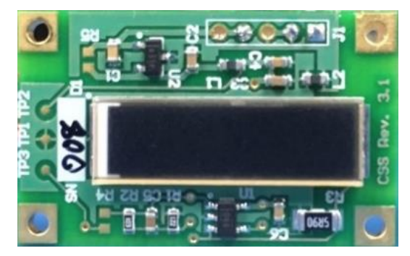
Components Survey Results – Champions
VectorNav VN-100 Inertial Measurement Unit
3-axis accelerometer, gyro, magnetometer
22 x 24 x 3 mm
$500 (+$300 for thermal calibration)
AMA MAI CubeSat Sun Sensor
28 x 17 x 2 mm
Price not listed

Slide 5
Questions Summary
What's the overall budget for the mission?
Is there a requirement for rad hardening for sensors?
We have found cheap MEMS gyros but not sure if we can use them because they aren't rad hardened.
What is the length of the mission?
What are the requirements for orbit determination?
Will we have/need a GPS receiver?
Coupled power/control problem?
Where does the FSW end and firmware begin?

Slide 6
Next Steps
Review of attitude dynamics, filtering methods, and attitude control
Build deeper familiarity with the magnetorquer-only control algorithm
Architect the flight and testing software

